Slide 1

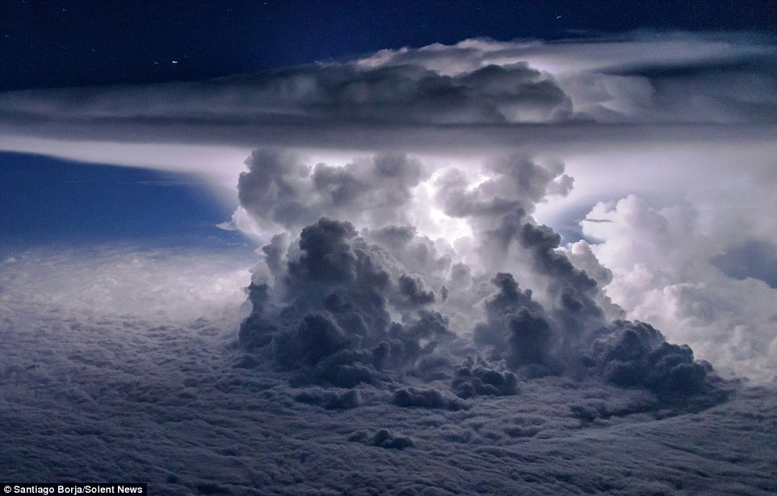
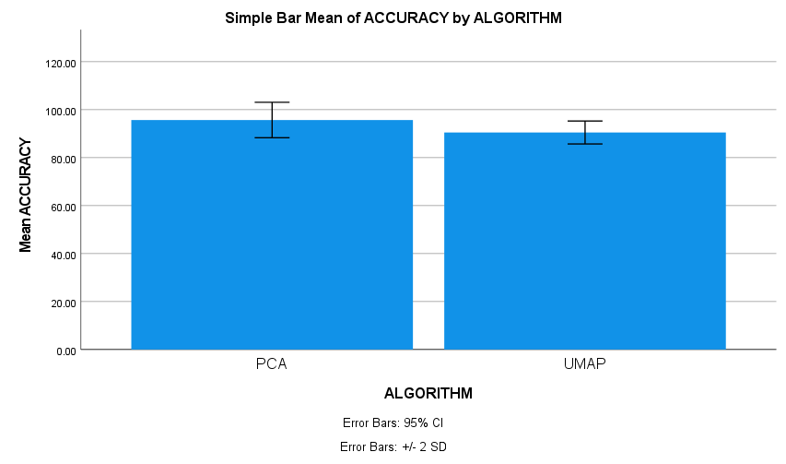
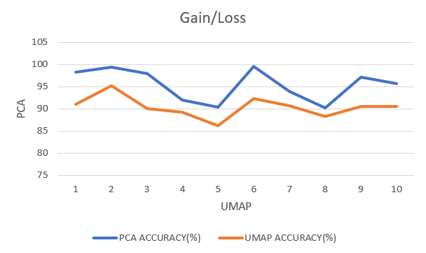
Name: Revanth Alli Register Number: 192110492
Guided by: Dr. T. P. Anithaashri
Ms. Poorani.S
Guided by Dr. Mary Valantina. G
Comparative Analysis of Principal Component Analysis over Uniform Manifold Approximation and Projection Algorithm in Predicting the Indian National Satellite System (INSAT) - Enhanced Celestial Clouds.
INTRODUCTION
To compare Principal Component Analysis (PCA) with Uniform Manifold Approximation and Projection (UMAP) in predicting INSAT-enhanced celestial clouds, aiming for enhanced prediction accuracy and understanding algorithmic efficacy.
Overview of dimension reduction techniques, such as PCA and UMAP, and their roles in data preprocessing for cloud prediction models.
Significance of comparative analysis between PCA and UMAP algorithms in determining the more effective approach for INSAT cloud prediction.
Brief explanation of the evaluation metrics used to assess the performance of PCA and UMAP in this study.
The study utilizes INSAT-enhanced celestial cloud imagery as the primary dataset, facilitating comparative analysis between PCA and UMAP in reduction of cloud images and behaviors captured by INSAT satellites.
Cloud image captured by INSAT
MATERIALS AND METHODS
PCA Module
Dimensionality Reduction
Input data INSAT-enhanced celestial cloud imagery
Preprocessing Normalization, Feature Extraction
Comparative Analysis Prediction Metrics
Output
Comparative Insight
UMAP Module
Non-linear Dimensionality Reduction
RESULTS
Algorithm | N | Mean | std.deviation | Std.error mean
Accuracy Principal component analysis algorithm uniform manifold approximation and projection algorithm | 10 10 | 95.6820 90.4850 | 3.69281 2.39426 | 1.6777 .75713
PCA and UMAP
Statistical Analysis values
Gain and Loss of PCA and UMAP
Principal component analysis (PCA) and the Uniform Manifold Approximation and Projection approach (UMAP) are examined in this work. The results show that PCA, the suggested approach, provides greater than accuracy (95.68%) than UMAP (90.48%).
The principal component analysis Algorithm and the uniform manifold approximation and projection algorithm have the values of the Mean accuracy, Standard Deviation, and Standard Error .
DISCUSSION AND CONCLUSION
According to the investigation findings, the Principal Component Analysis outshone the Consistent of Uniform Manifold Approximation and Projection algorithm with elevated precision of 95.68%.
Based on the independent sample t-test, with the total sample size of 450, the significance value p=0.016 (p<0.05) exhibits that there is noteworthy disparity in the algorithms.
The accuracy of the Principal Component Analysis (PCA) Algorithm is 95.68% significantly superior to the other algorithm.
Through this exploration, it is deduced that Principal Component Analysis (PCA) algorithm has elevated precision comparing with Uniform Manifold Approximation and Projection algorithm for compelling examination on dimension decrease.
PCA and UMAP have the potential to be made much more useful in image dimensionality reduction applications through additional research and development.
BIBLIOGRAPHY
Ros, Frederic, and Rabia Riad. 2024. Feature and Dimensionality Reduction for Clustering with Deep Learning. Springer Nature.
Deshpande, Anand, Vania V. Estrela, and Navid Razmjooy. 2021. Computational Intelligence Methods for Super-Resolution in Image Processing Applications. Springer Nature.
Deshpande, Anand, Vania V. Estrela, and Navid Razmjooy. 2021. Computational Intelligence Methods for Super-Resolution in Image Processing Applications. Springer Nature.
Das, Rik, Sourav De, and Siddhartha Bhattacharyya. 2018. Feature Dimension Reduction for Content-Based Image Identification. IGI Global.
Xu, Yude, Suixiang Huang, Zhencong Li, Libing Dai, Hao Wu, Peigeng Wang, Xiguan Yao, et al. 2023. “Single-Cell RNA Landscape of Osteoimmune Microenvironment in Osteoporotic Vertebral Compression Fracture and Kümmell’s Disease.” Frontiers in Cell and Developmental Biology 11 (December): 1276098.

